Slide 1
Inflation and
Keeping Hold of your Money
Look after the pennies and…

Slide 2
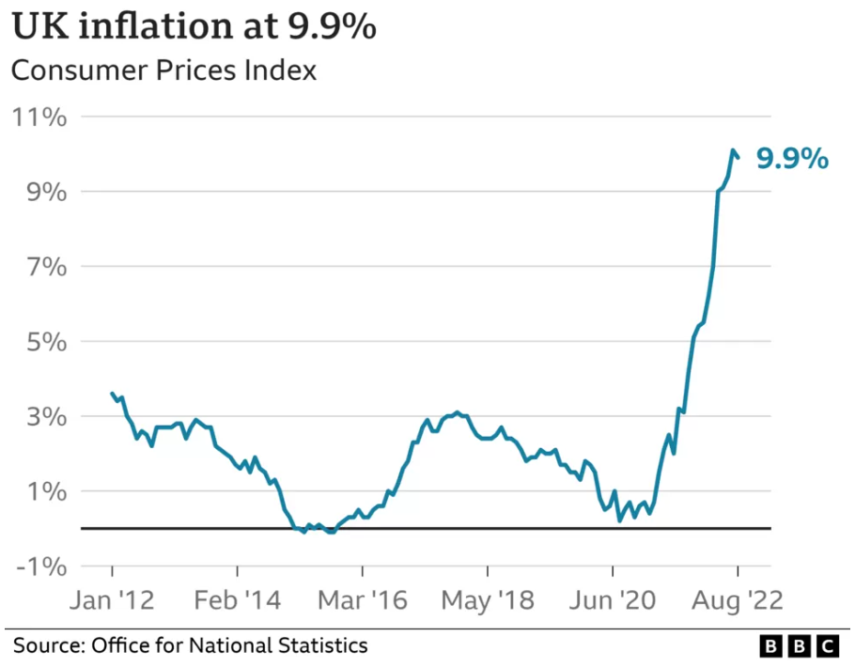
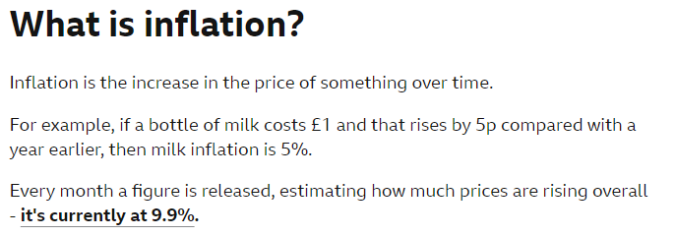
Inflation
(2022)
What is inflation?
Can you beat it?
Note that a new figure is released each month but that this figure compares a year-on-year price and not a month-on-month price
BBC News, 14th September 2022

Slide 3
Inflation
(2022)
What is inflation?
Can you beat it?
Note that a new figure is released each month but that this figure compares a year-on-year price and not a month-on-month price
BBC News, 14th September 2022
https://www.ons.gov.uk/economy/inflationandpriceindices/bulletins/consumerpriceinflation/august2023

Slide 4
UK Inflation Since Jan 2021

Slide 5
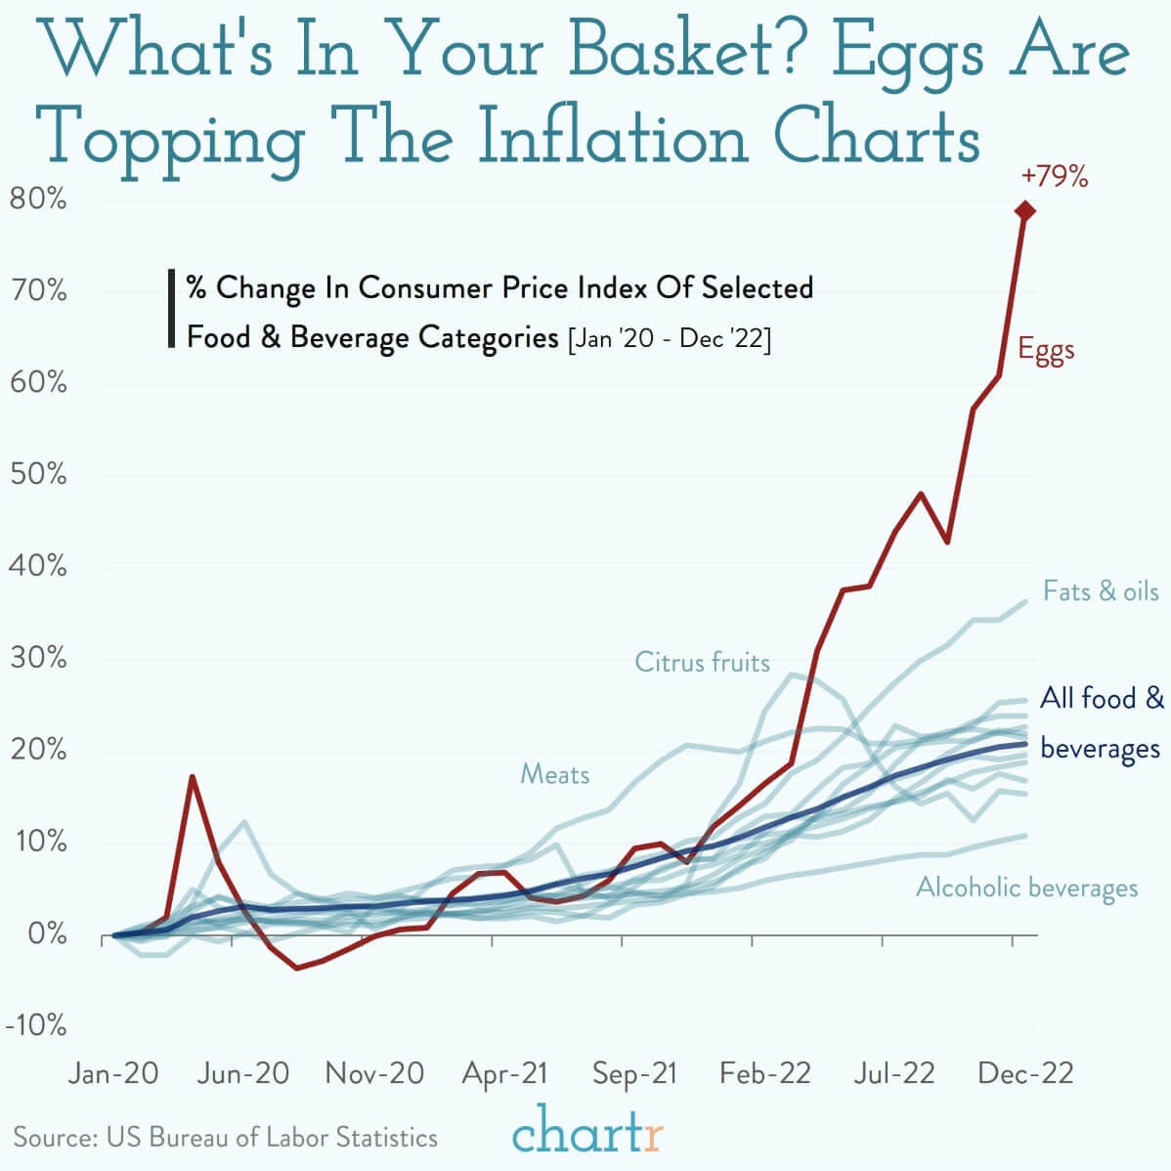
Different goods inflate
at different rates…

Slide 6
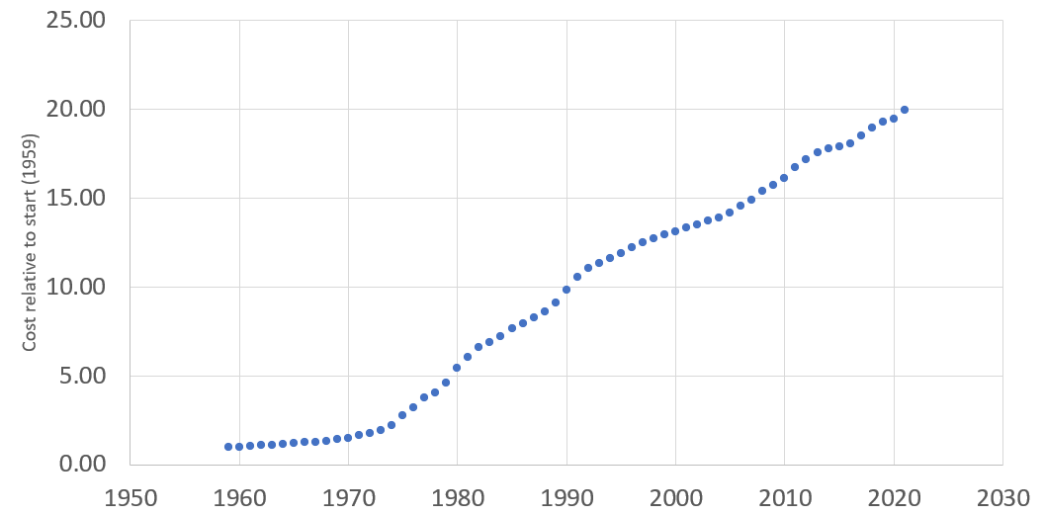
UK Inflation Since Records Began in 1959

Slide 7
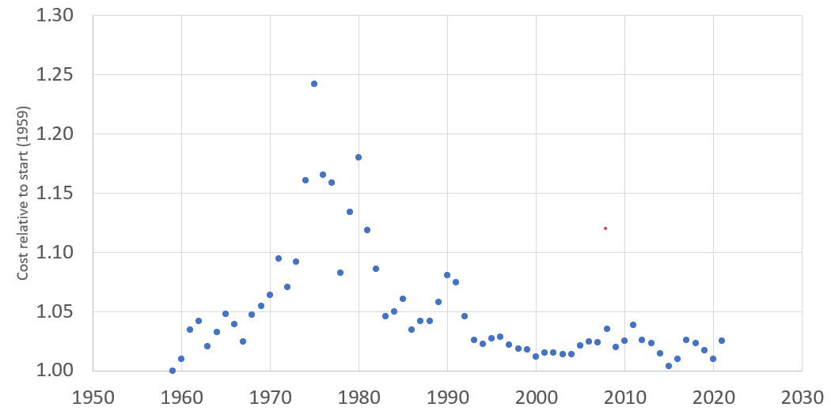
UK Inflation Since Records Began in 1959
Link to Inflation Historical

Slide 8
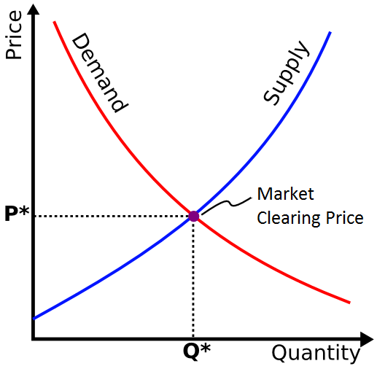
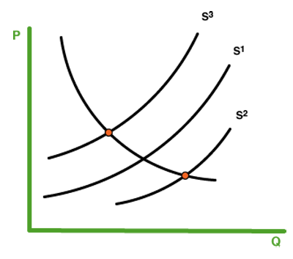
Supply and Demand
If demand goes up or supply goes down… prices increase
If demand goes down or supply goes up… prices decrease
It’s a whole group of curves

Slide 9
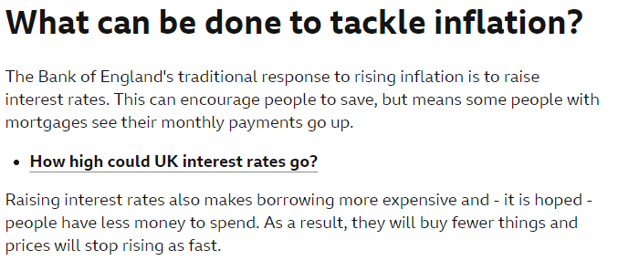
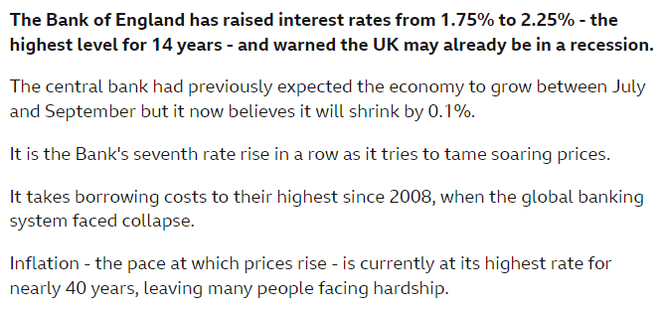
Supply and Demand… and Inflation
BBC News, 14th September 2022
BBC News, 22nd September 2022

Slide 10
Keeping Hold of your Money

Slide 11
Keeping Hold of your Money - car insurance
https://www.moneysavingexpert.com/insurance/car-insurance/#buying

Slide 12
Keeping Hold of your Money - never pay full price
Use comparison websites
Read Martin Lewis’s suggestions and advice
Search for voucher codes
Sign up for mailing list discounts (then leave after purchase)
Use Top Cashback
Use Hot UK deals
Employee discount schemes

Slide 13
Keeping Hold of your Money - challenge…!
Find the cheapest iphone deal
We’re looking for cheapest total price over 2 years
Last year’s iphone
5Gb+
4G or 5G

Slide 14
This Week's Top Tips
https://www.moneysavingexpert.com/latesttip/
10th October 2023…
Free Wills Month for age 55+ every October and March
Amazon Prime Day 10-11th October
£200 + 8% regular saver at Nationwide, £175 + 7% at First Direct
5.12% on $≤$ £5k at Barclays, 4.1% on £££ at Chase
https://www.moneysavingexpert.com/deals/
https://www.moneysavingexpert.com/students/

